Slide 1


TeamItaly CTF 2022
Challenge: ImageStore / ImageStore2
Category: misc
Author: Antonio Napolitano <napaalm>

Slide 2
ImageStore
Simple CLI service to upload and download image files.
The goal is to read /flag.

Slide 3
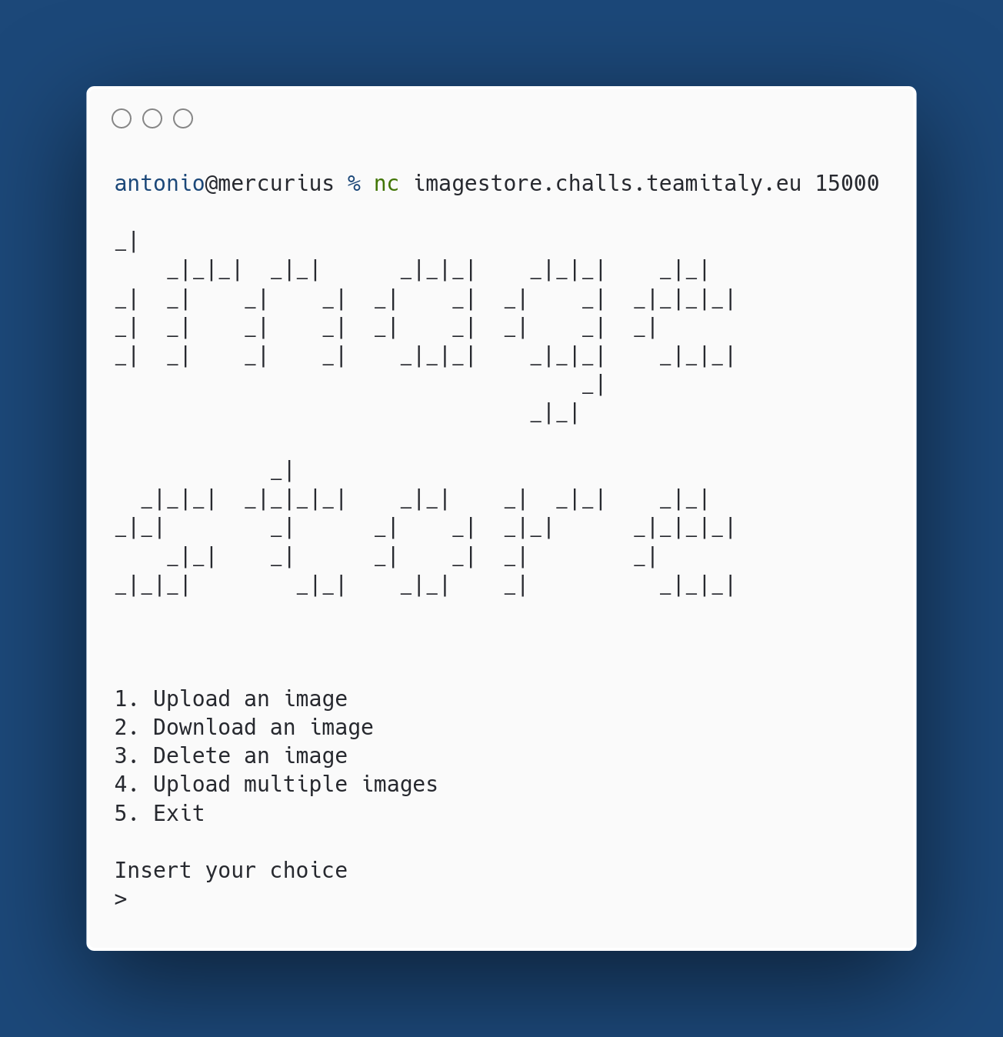

Slide 4
Let’s read the source code!

Slide 5
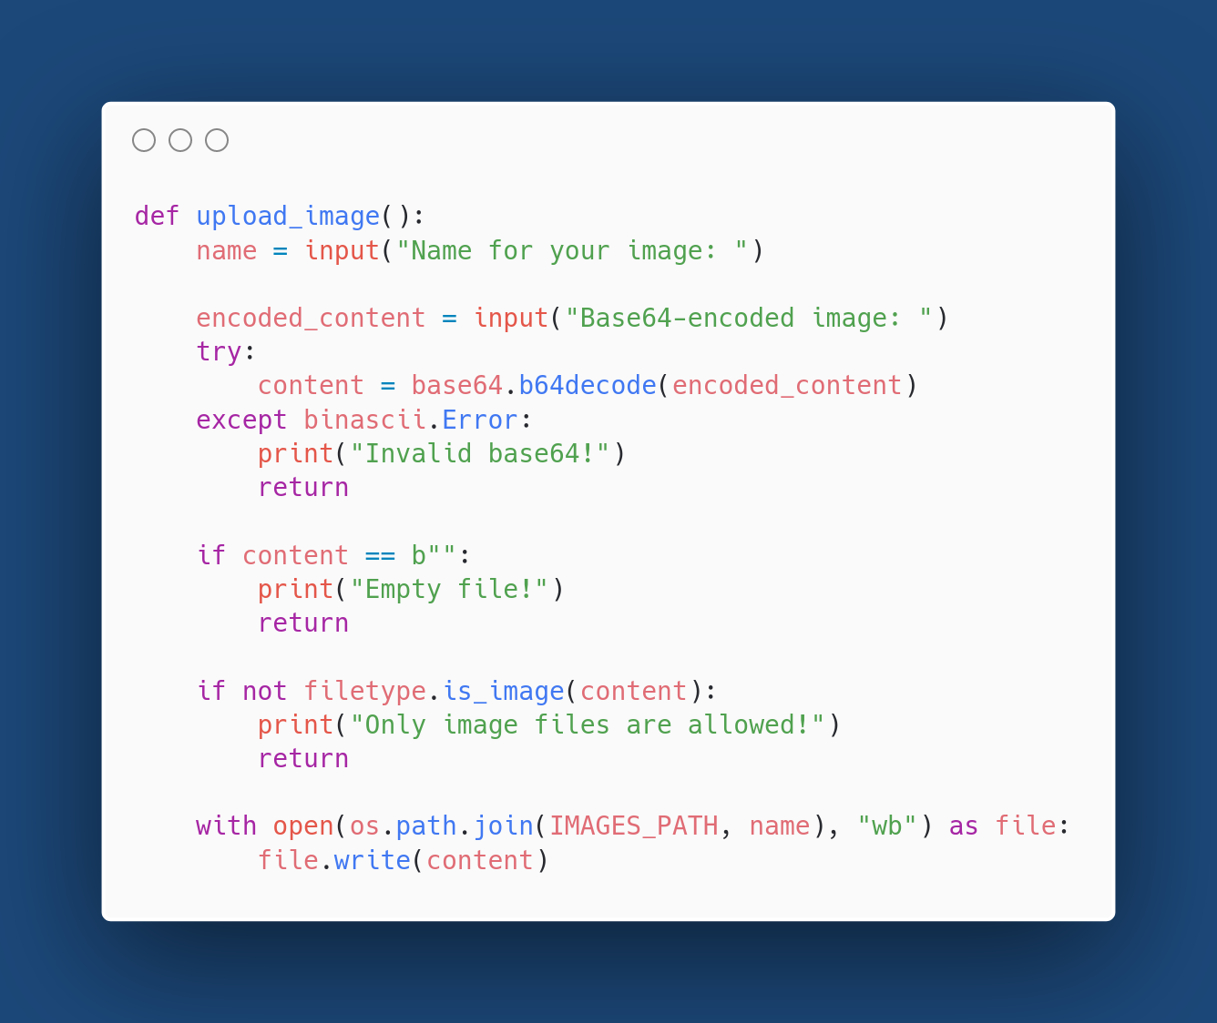

Slide 6
Bug 1: path traversal in upload_image function

Slide 7

Path traversal

Slide 8
The bug
We can upload an image file anywhere in the filesystem!
Actually, we can upload any file as long as its first bytes (so-called Magic Bytes) are ones of a valid image. Let’s keep this in mind.

Slide 9

Checks only the Magic Bytes

Slide 10
Let’s move on

Slide 11
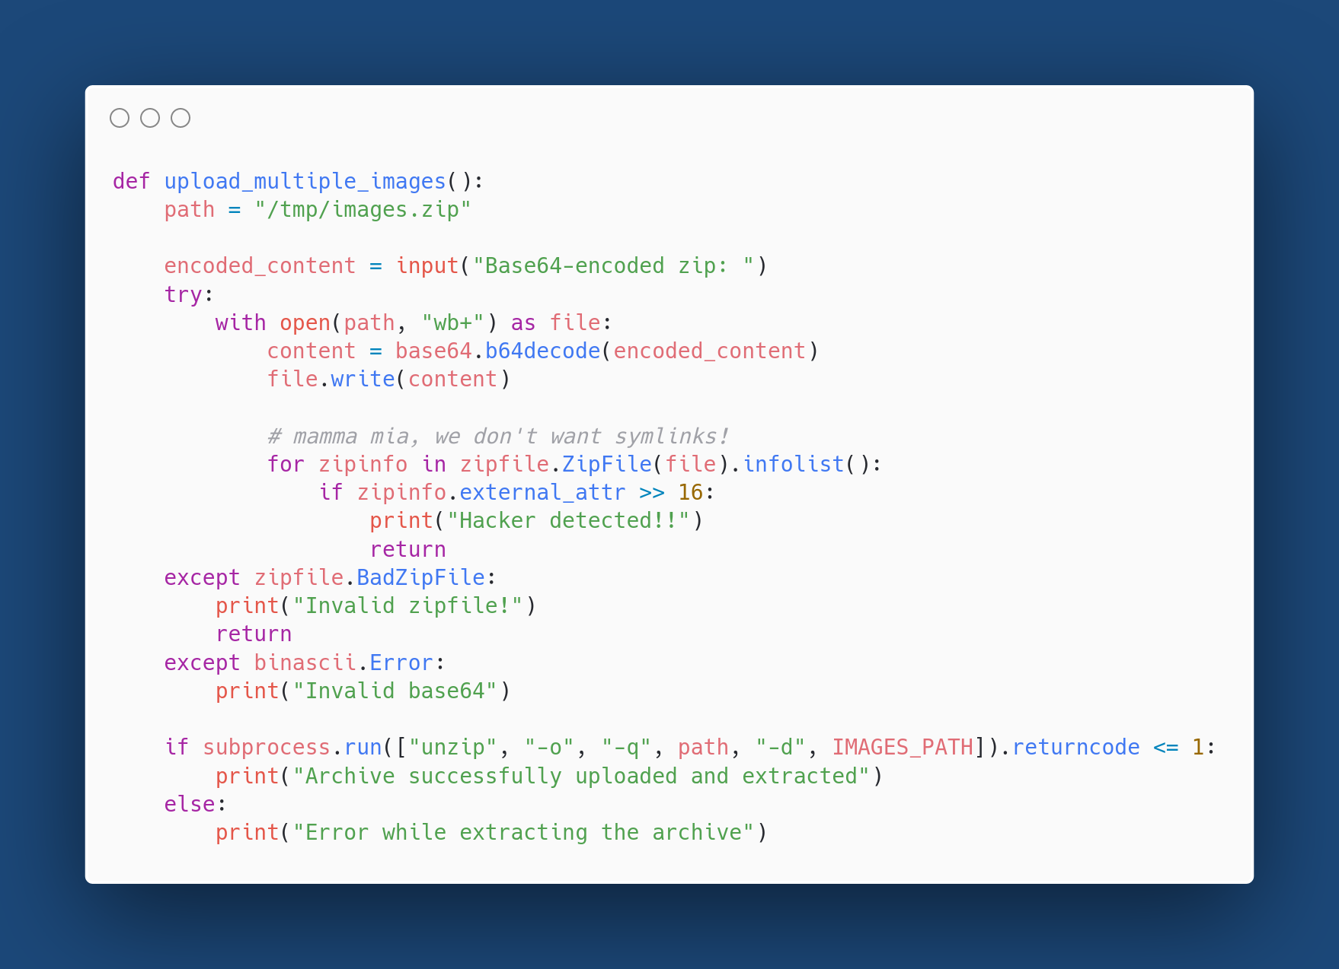

Slide 12
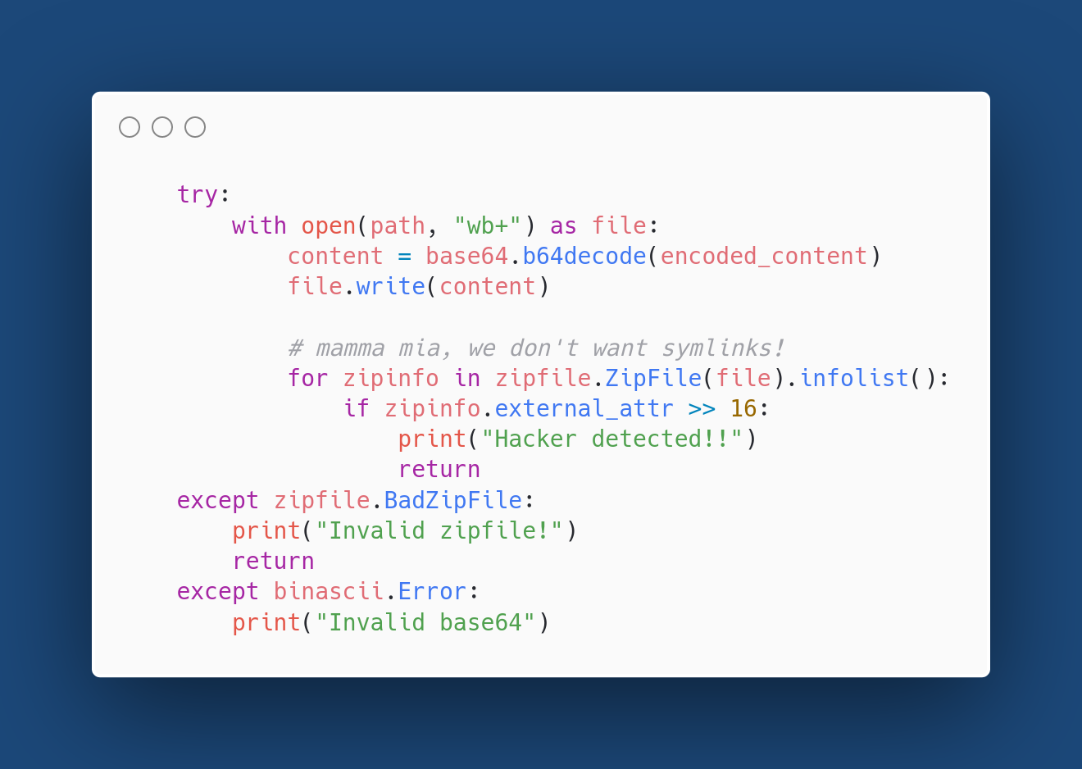

Slide 13
Bug 2: missing return in exception handler

Slide 14
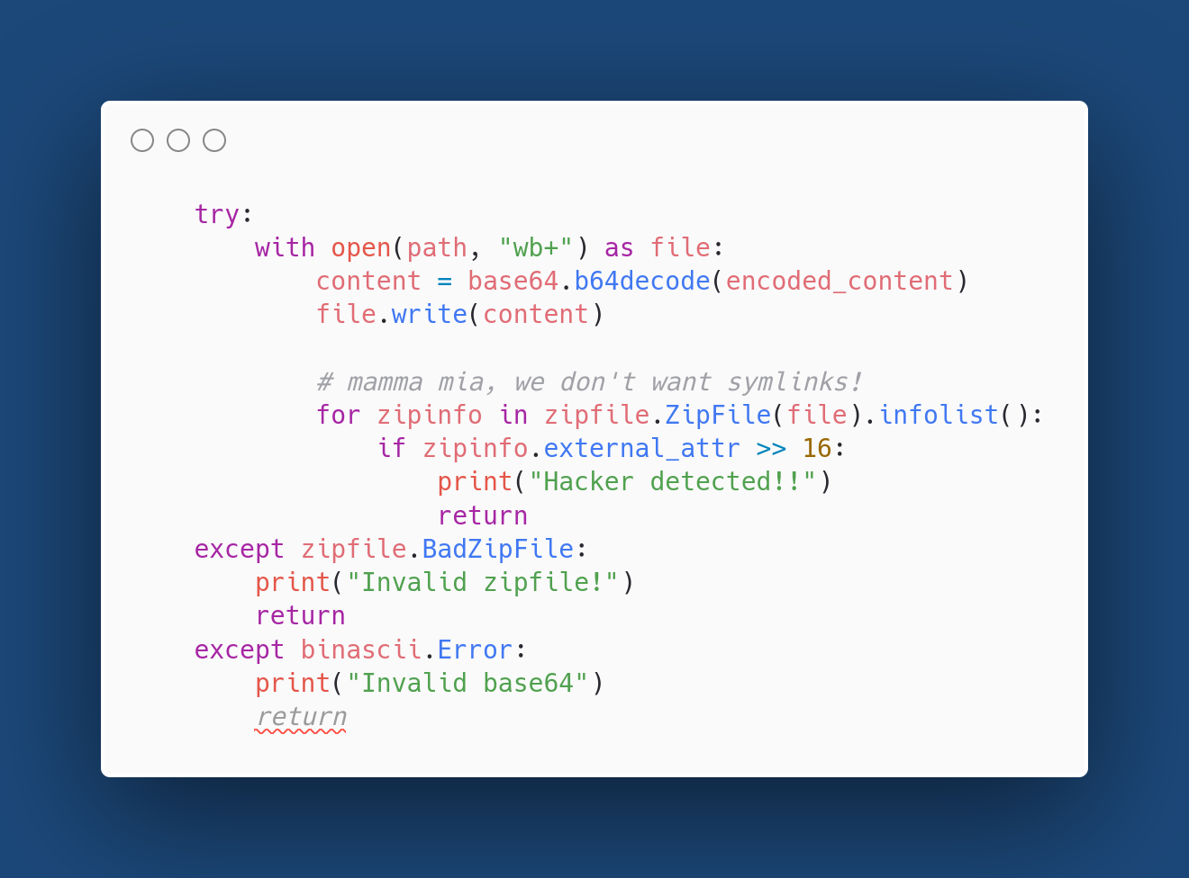
Missing

Slide 15
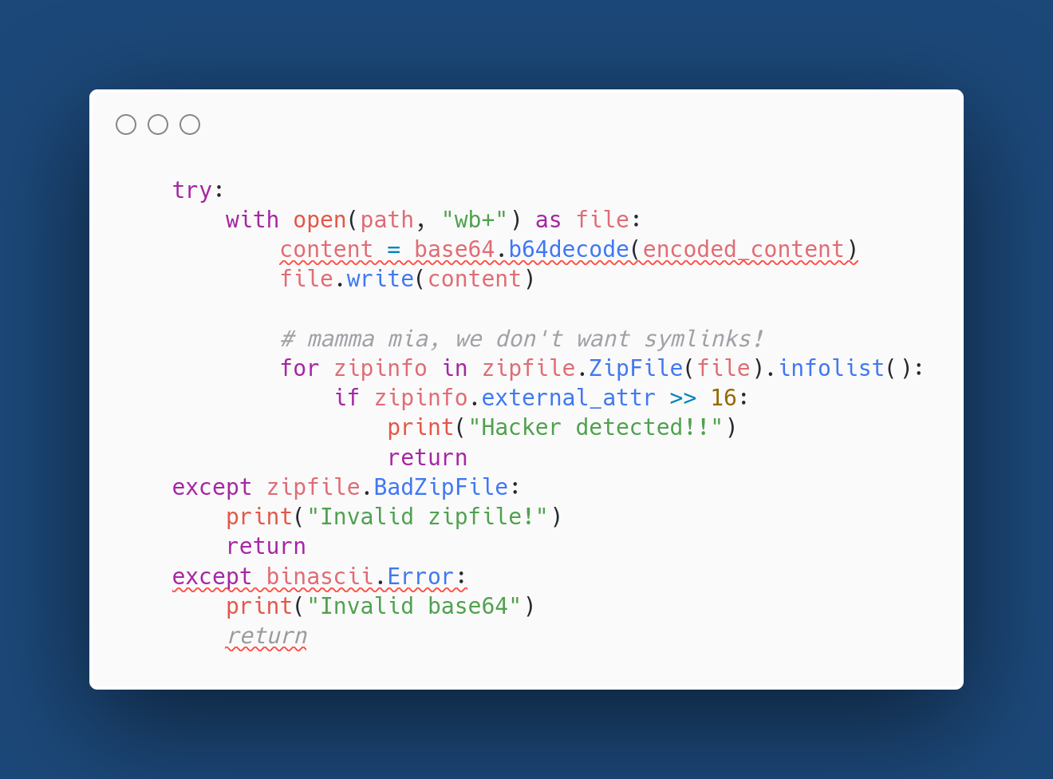
Trigger

Slide 16
Possible solution
Take advantage of path traversal bug to place a malicious zip containing a symlink to /flag in /tmp/images.zip.
Trigger badly written exception handler to bypass the symlink check and extract it (the Magic Bytes we added to fake an image file will be ignored).
Download the flag.

Slide 17
Problem: open overwrites our file

Slide 18
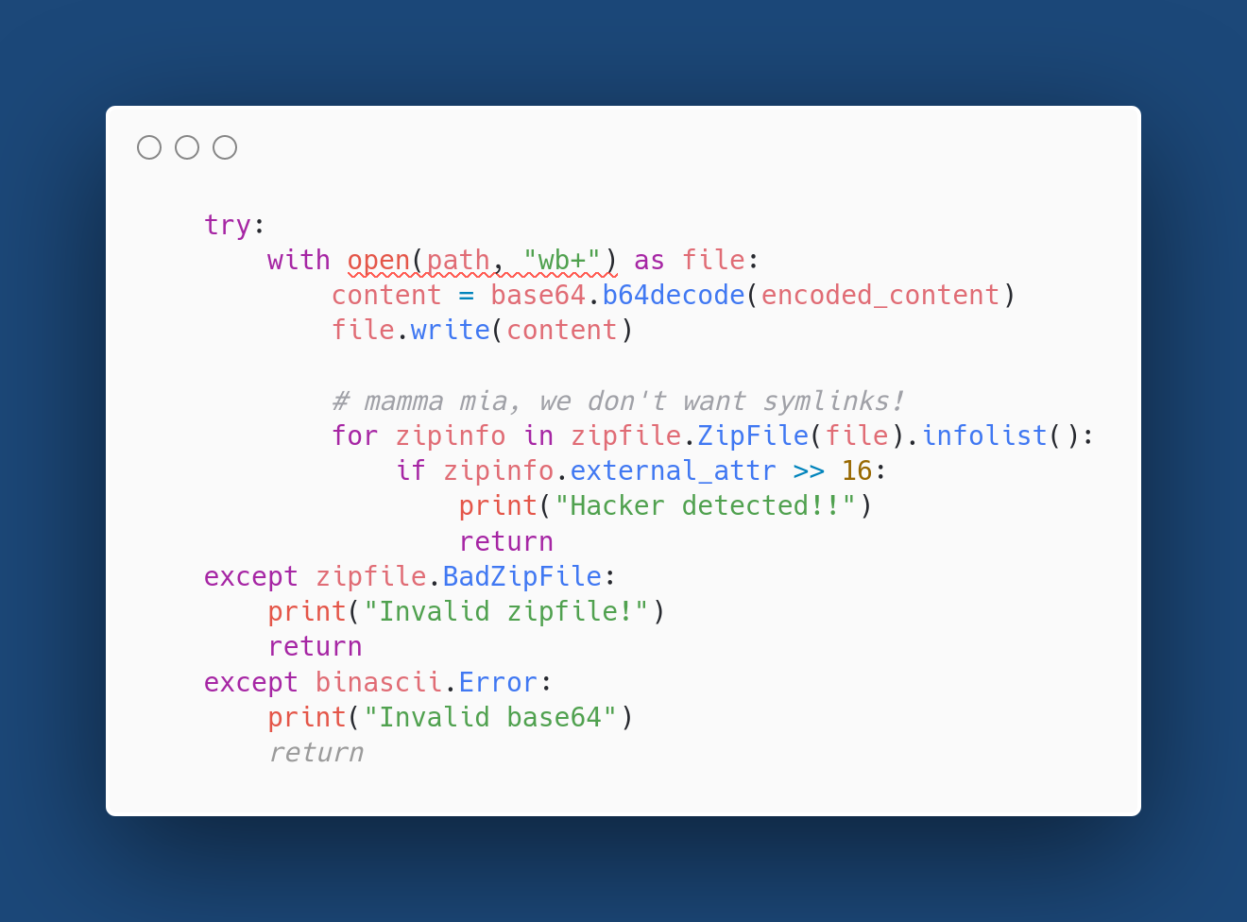

Slide 19
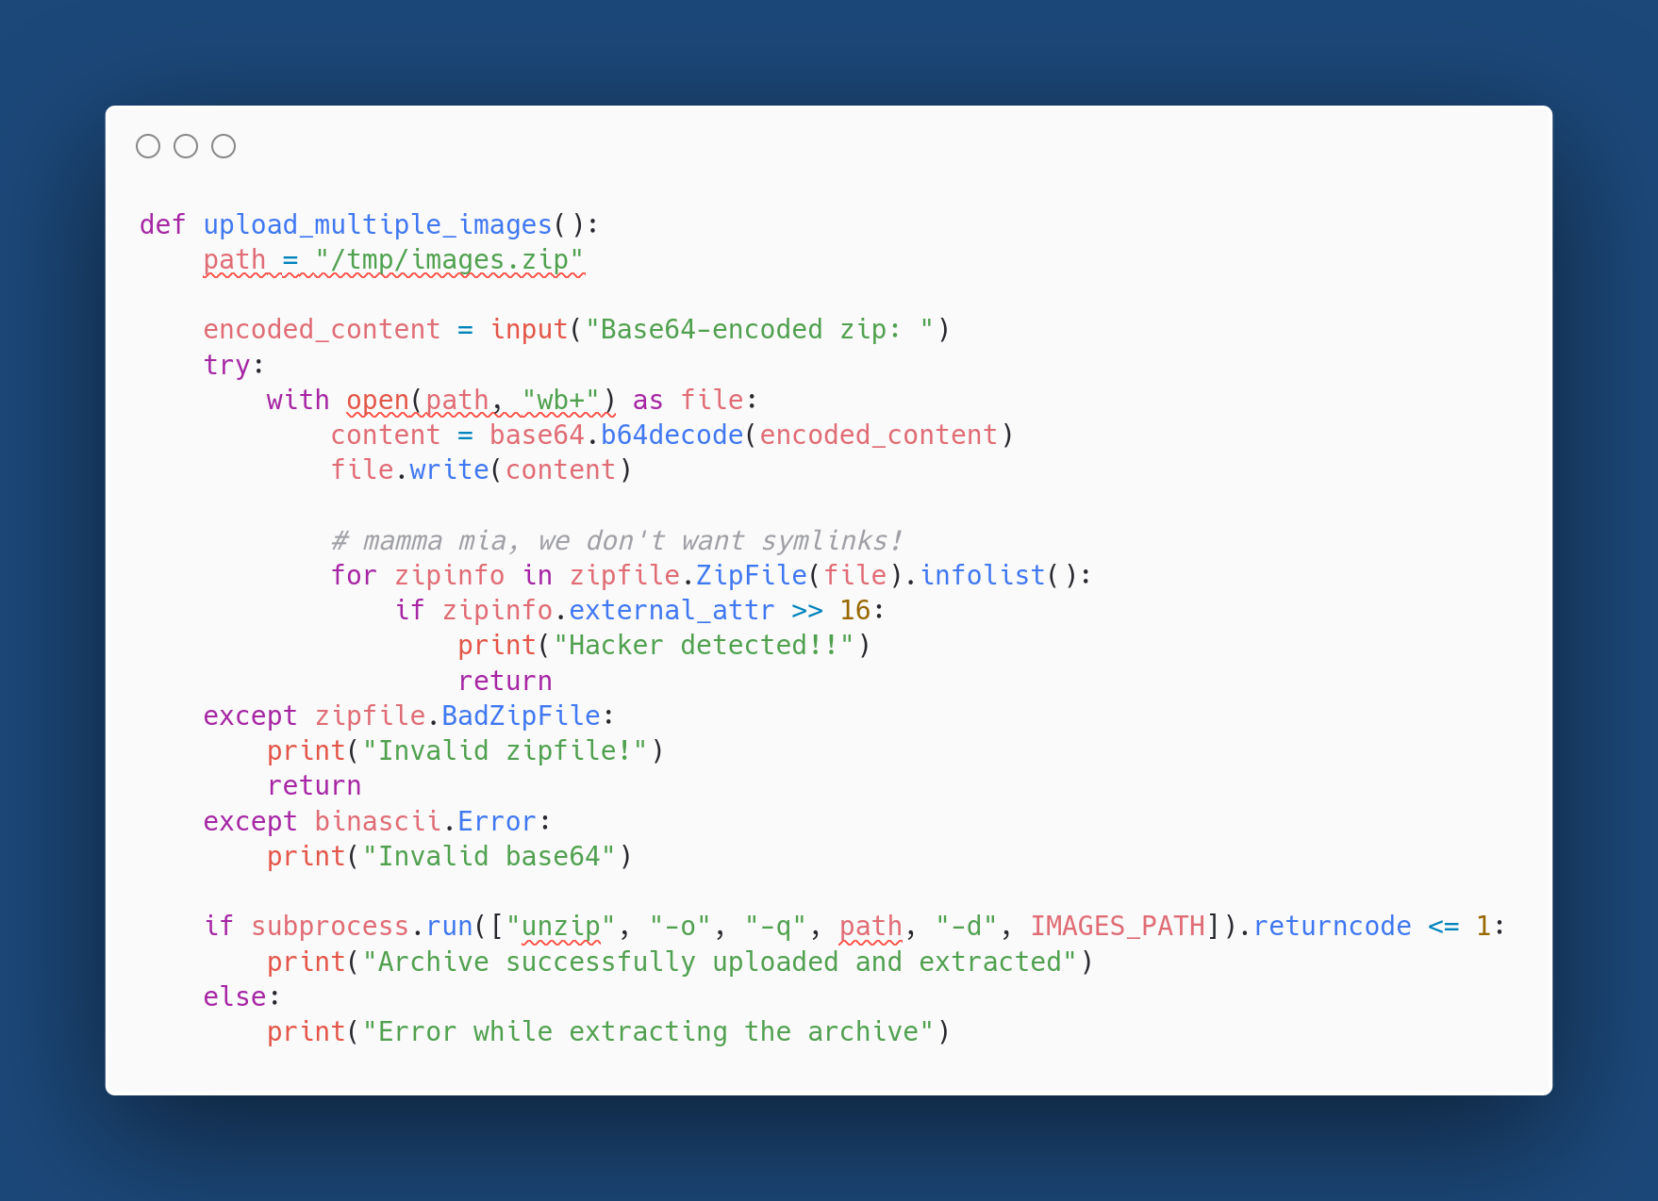

Slide 20
Let’s play a bit with unzip

Slide 21
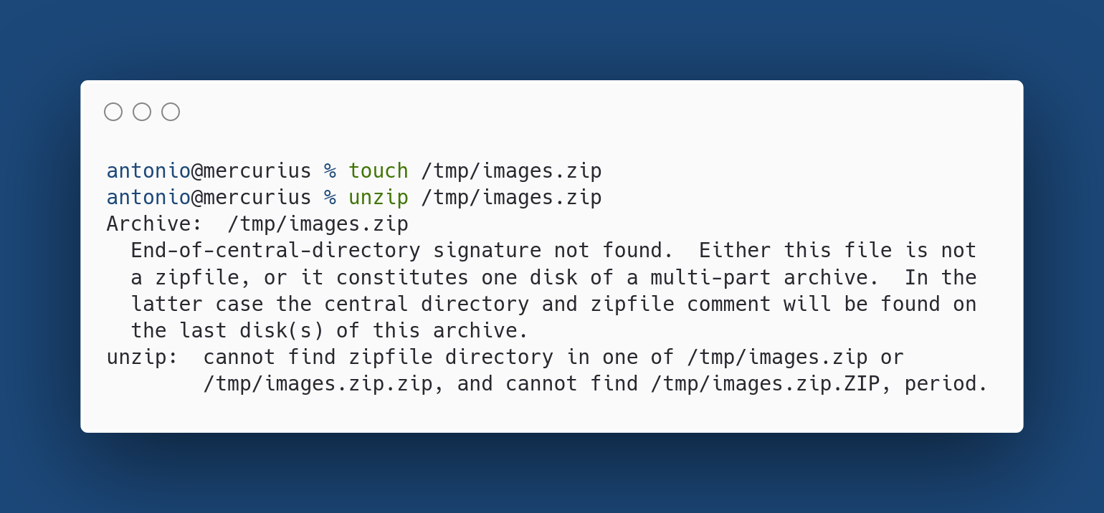
Empty file, like the one that open creates

Slide 22
There’s something interesting…

Slide 23
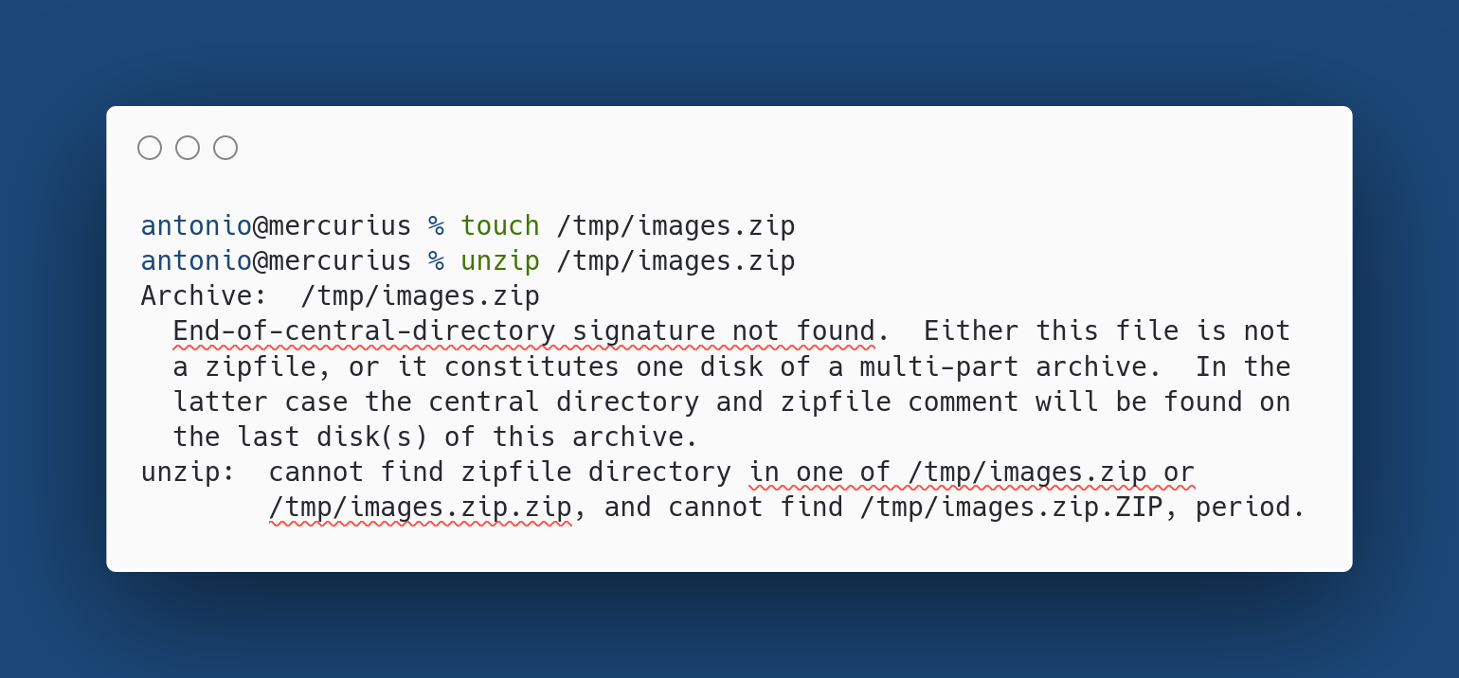

Slide 24
New solution
Take advantage of path traversal bug to place our malicious zip in /tmp/images.zip.zip.
Trigger badly written exception handler to bypass the zipfile check.
unzip will try to extract /tmp/images.zip, which doesn’t contain an EOCD header, so it will fallback to and extract /tmp/images.zip.zip!
Download the flag

Slide 25
The exploit

Slide 26
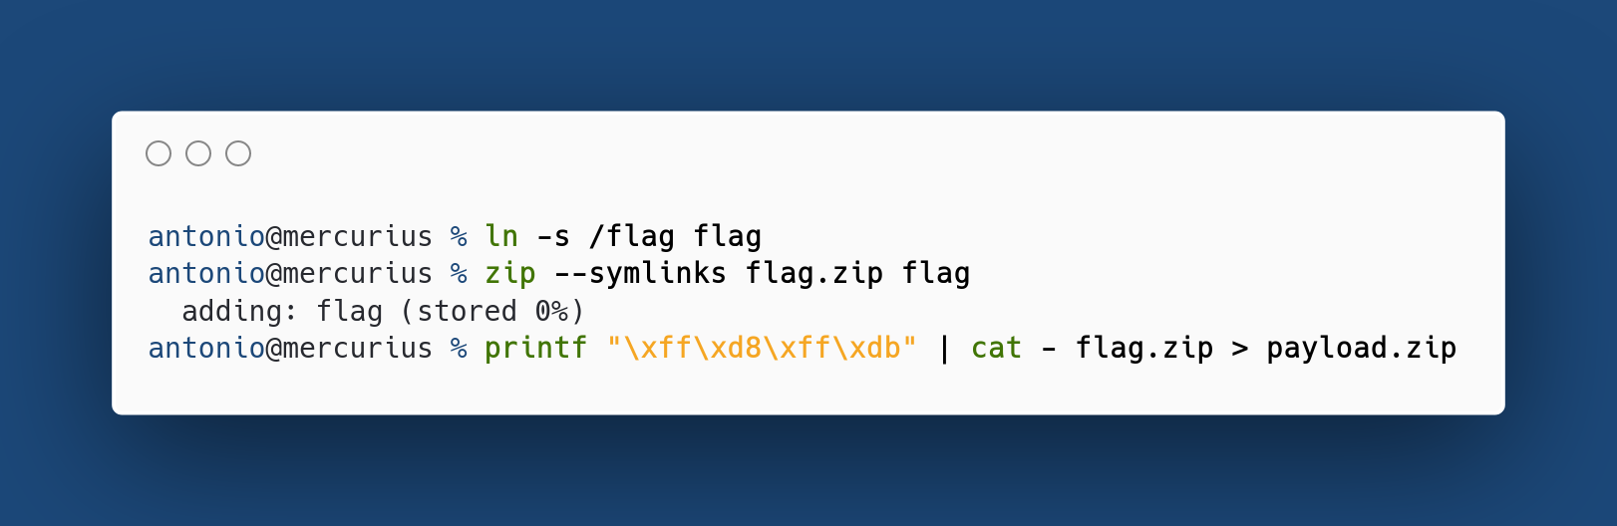
JPEG Magic Bytes

Slide 27
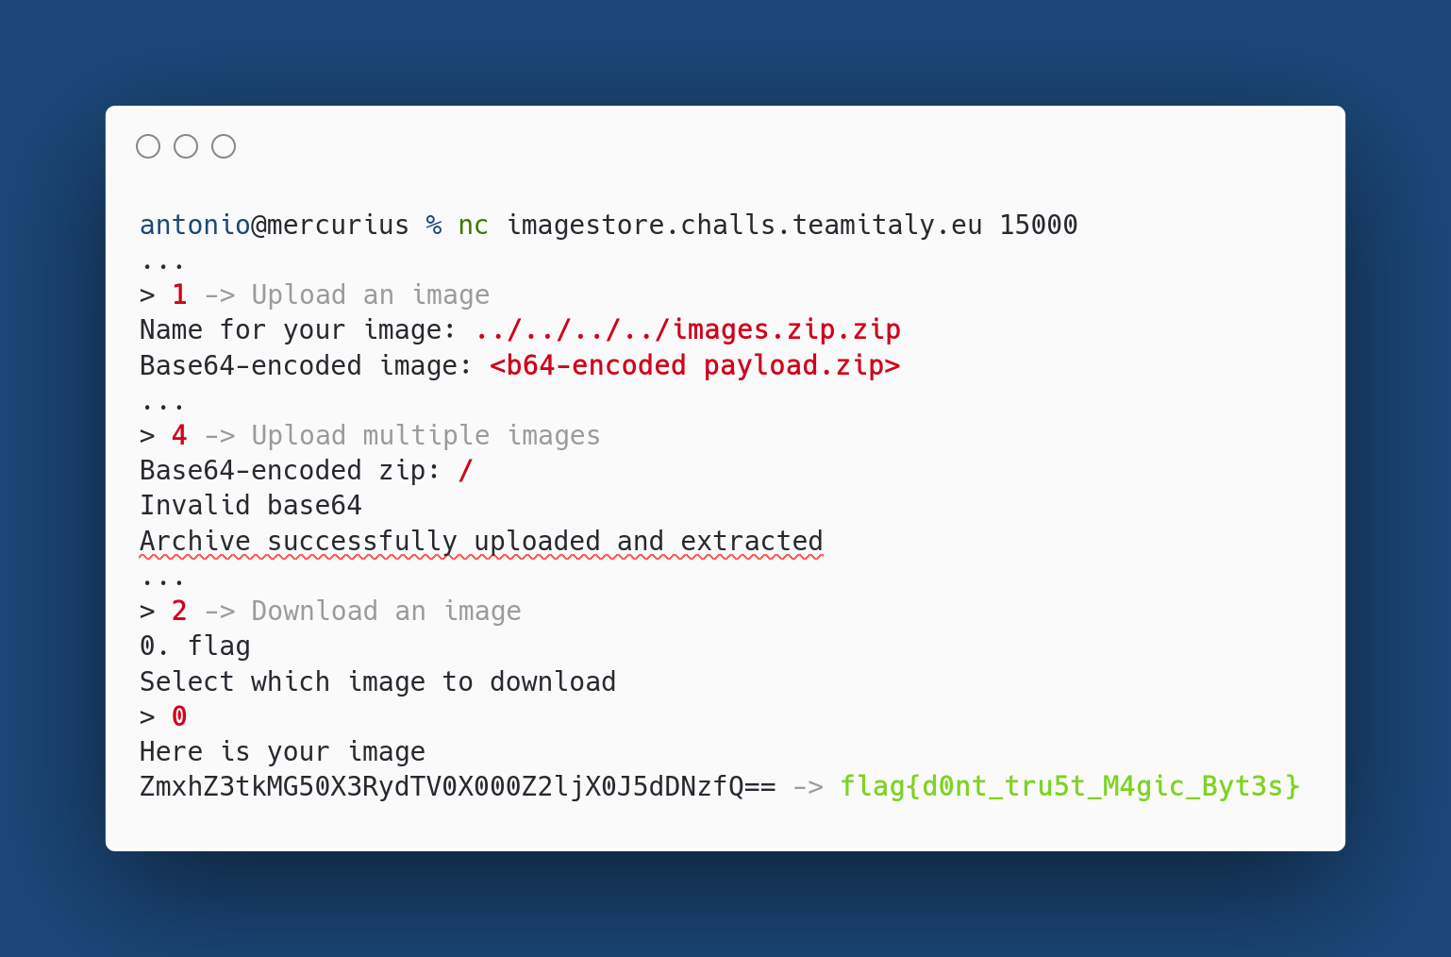
Invalid base64
Missing return and unzip that fallbacks to our payload

Slide 28
ImageStore2
2nd level! More checks, less bugs?

Slide 29
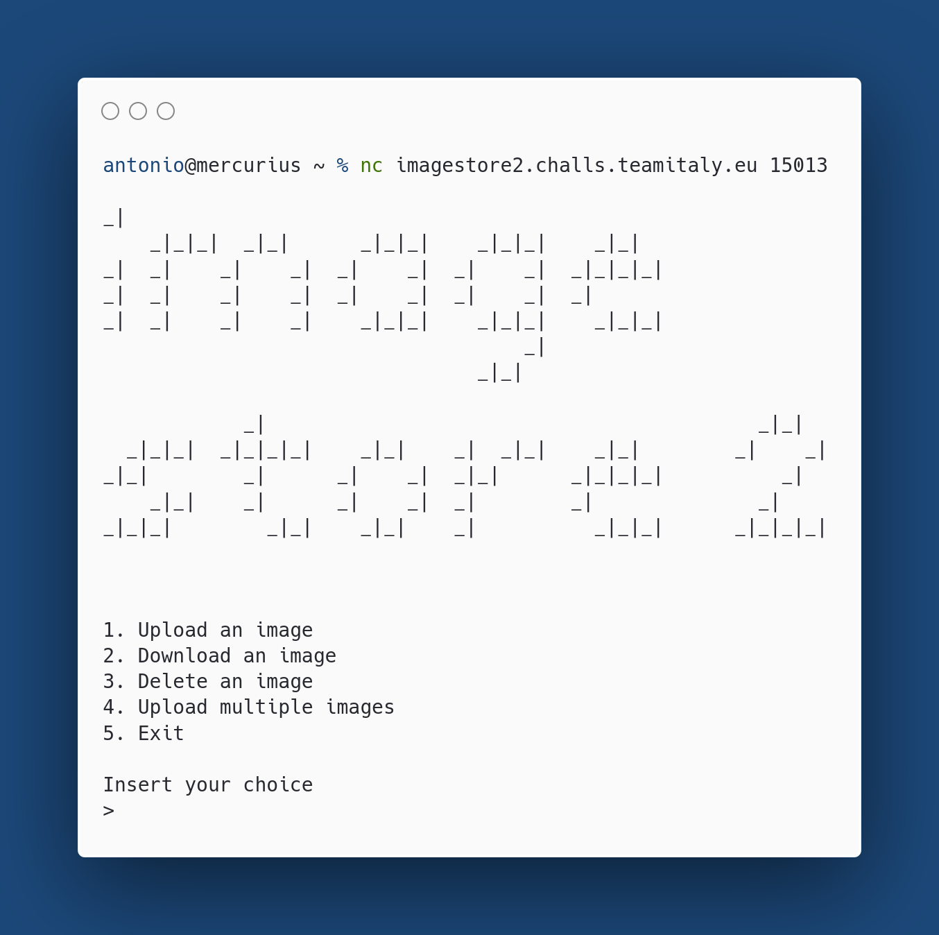

Slide 30
No difference in functionality: let’s check the source code

Slide 31
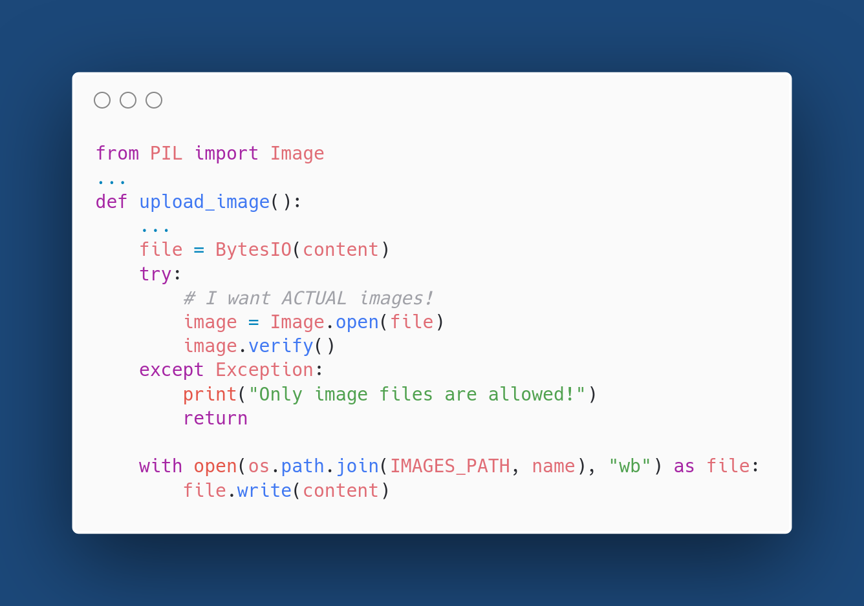

Slide 32
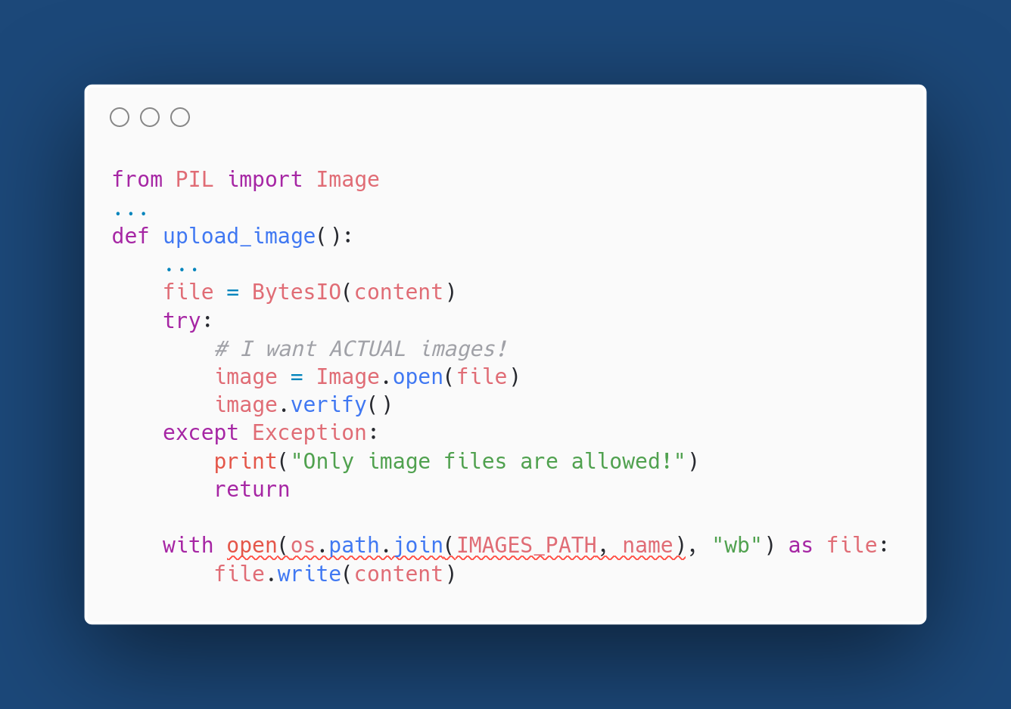
Same path traversal bug

Slide 33
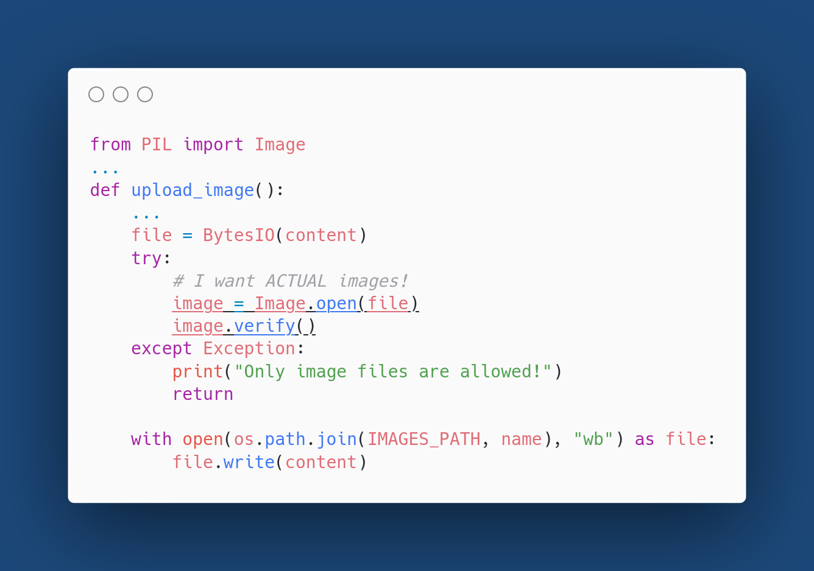
PIL checks for valid images

Slide 34
Polyglot file
If this was the only difference compared to the first challenge, our exploit would be very similar. We would just need to append our payload to a valid JPEG image. Both PIL and unzip ignore parasite data.

Slide 35
The real problem

Slide 36
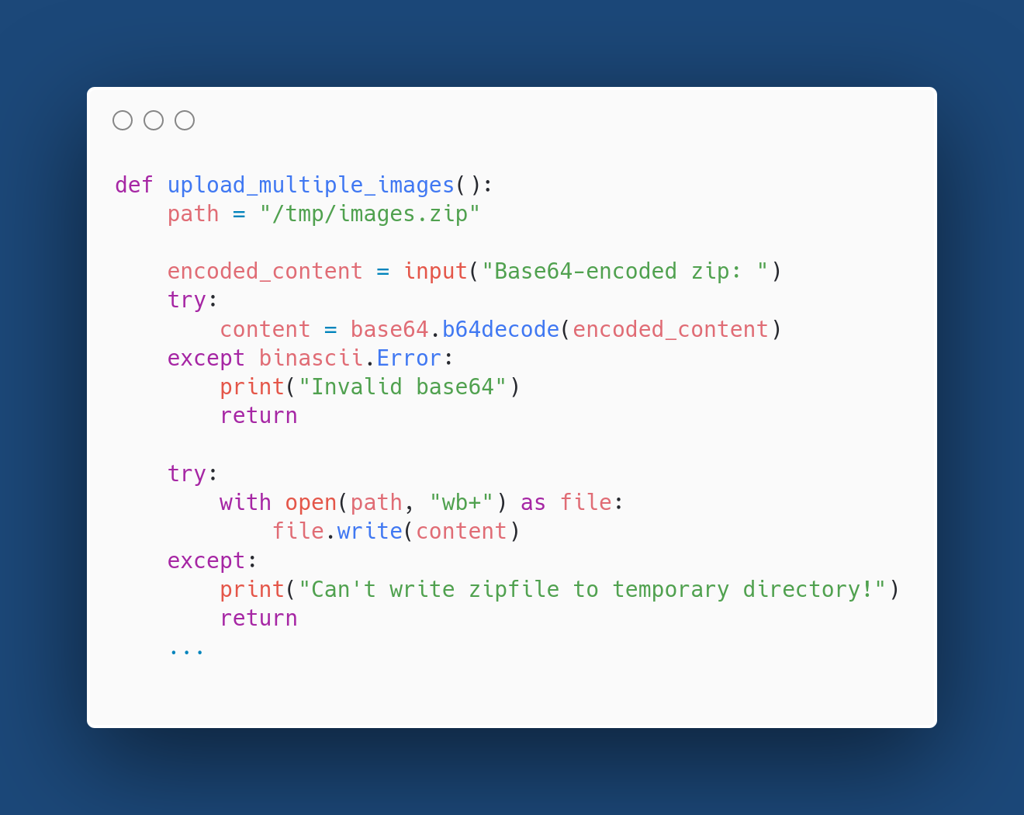
(continues)

Slide 37
😱
(continues)

Slide 38
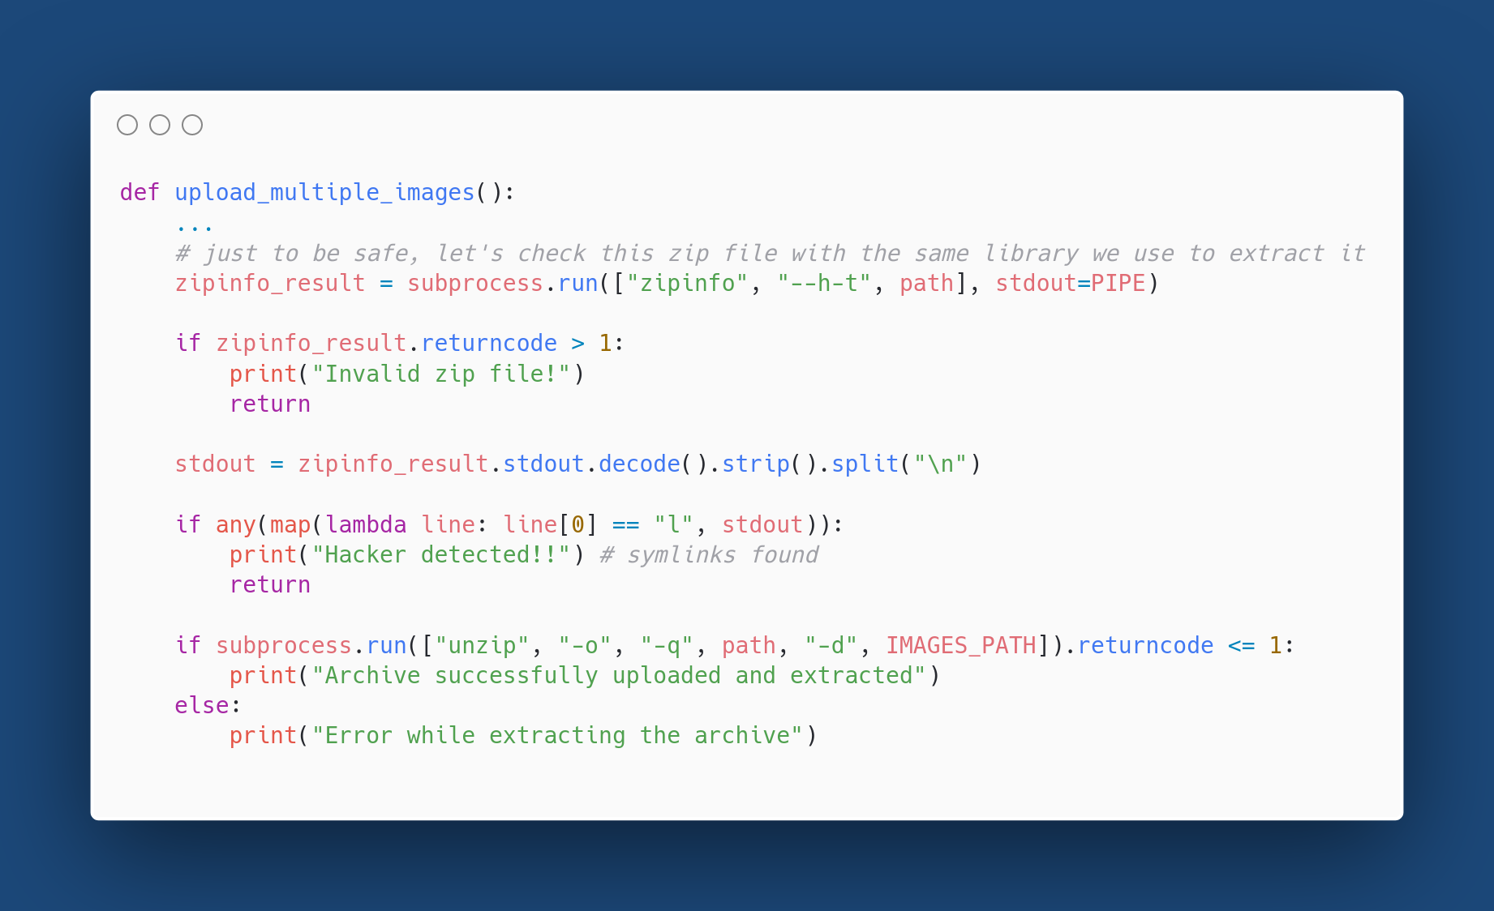

Slide 39
😱

Slide 40
upload_multiple_images looks safe
This function now has no obvious bugs. It even uses the same library to check and extract the file, so we can’t even hope for different implementations…

Slide 41
upload_multiple_images looks safe
This function now has no obvious bugs. It even uses the same library to check and extract the file, so we can’t even hope for different implementations…
…Or maybe we should?

Slide 42
Info-ZIP source code

Slide 43
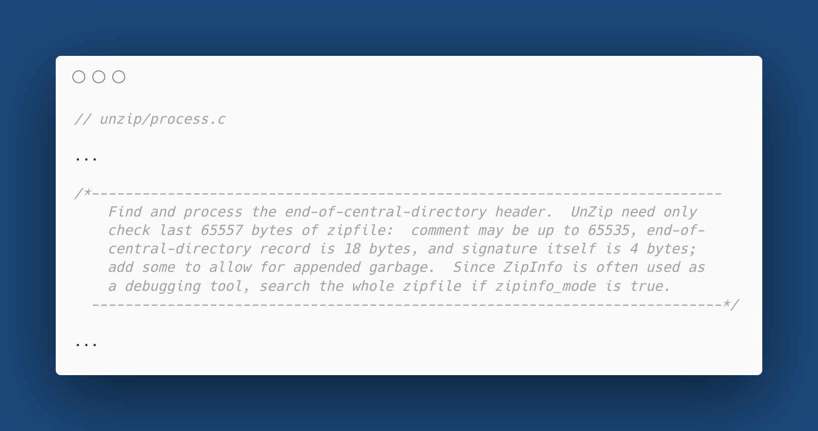

Slide 44
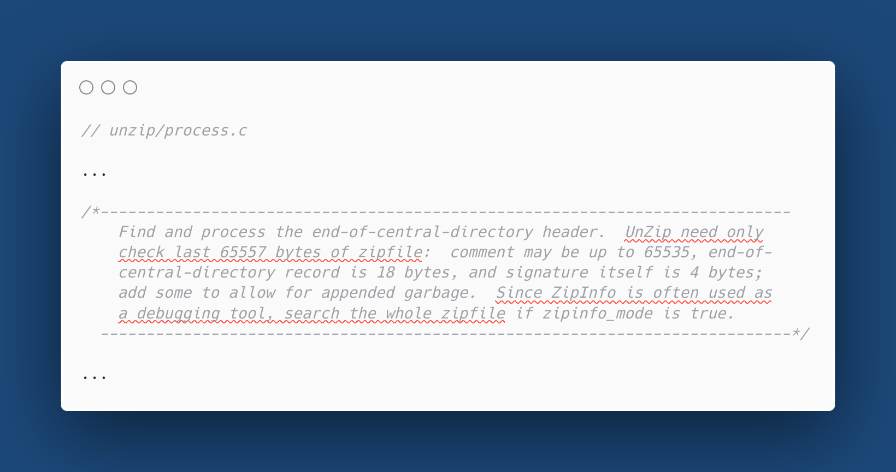

Slide 45
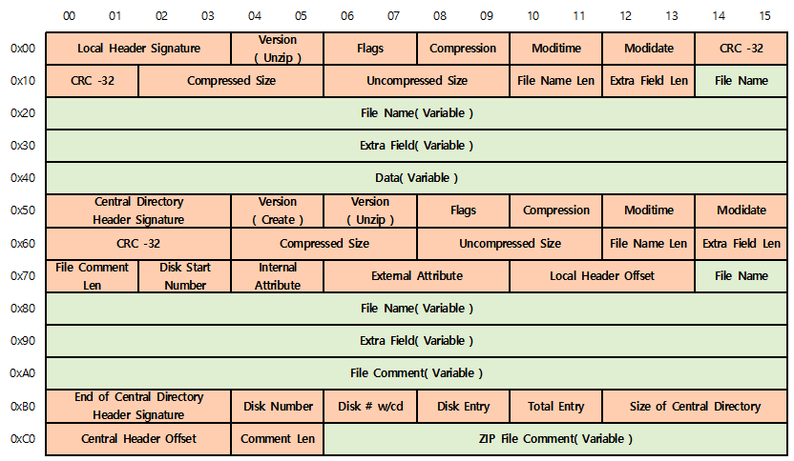

Slide 47
Exactly what we needed!

Slide 48
Solution
Upload the malicious payload through upload_images like in level 1 and put it in /tmp/images.zip.zip.
Craft a valid zipfile with more than ~66000 random data at its end, so that it passes the zipinfo check, but unzip thinks that it’s not valid, and extracts the payload.
Download /flag symlink.

Slide 49
The exploit

Slide 50
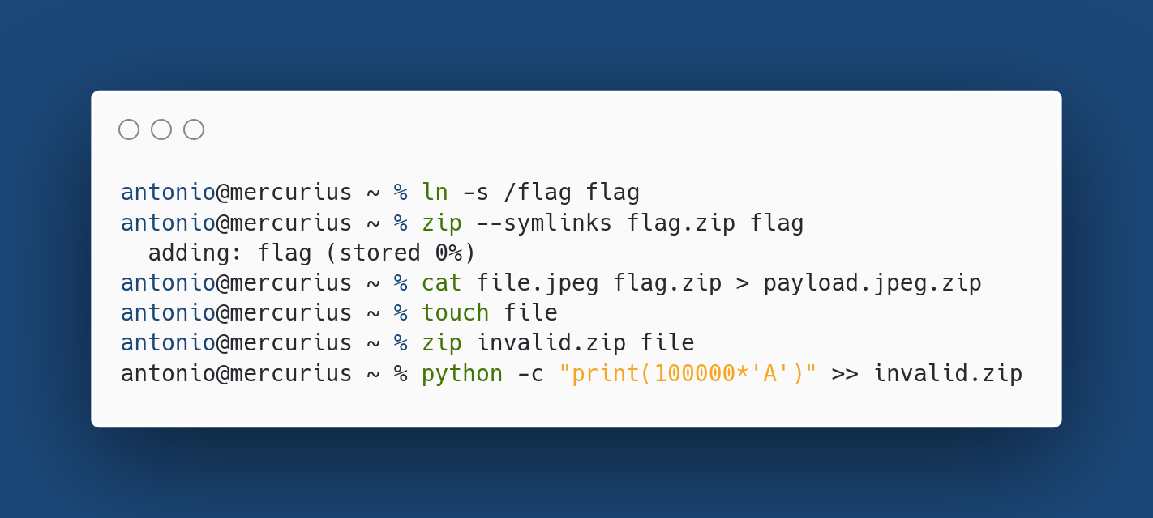
Polyglot file!

Slide 51
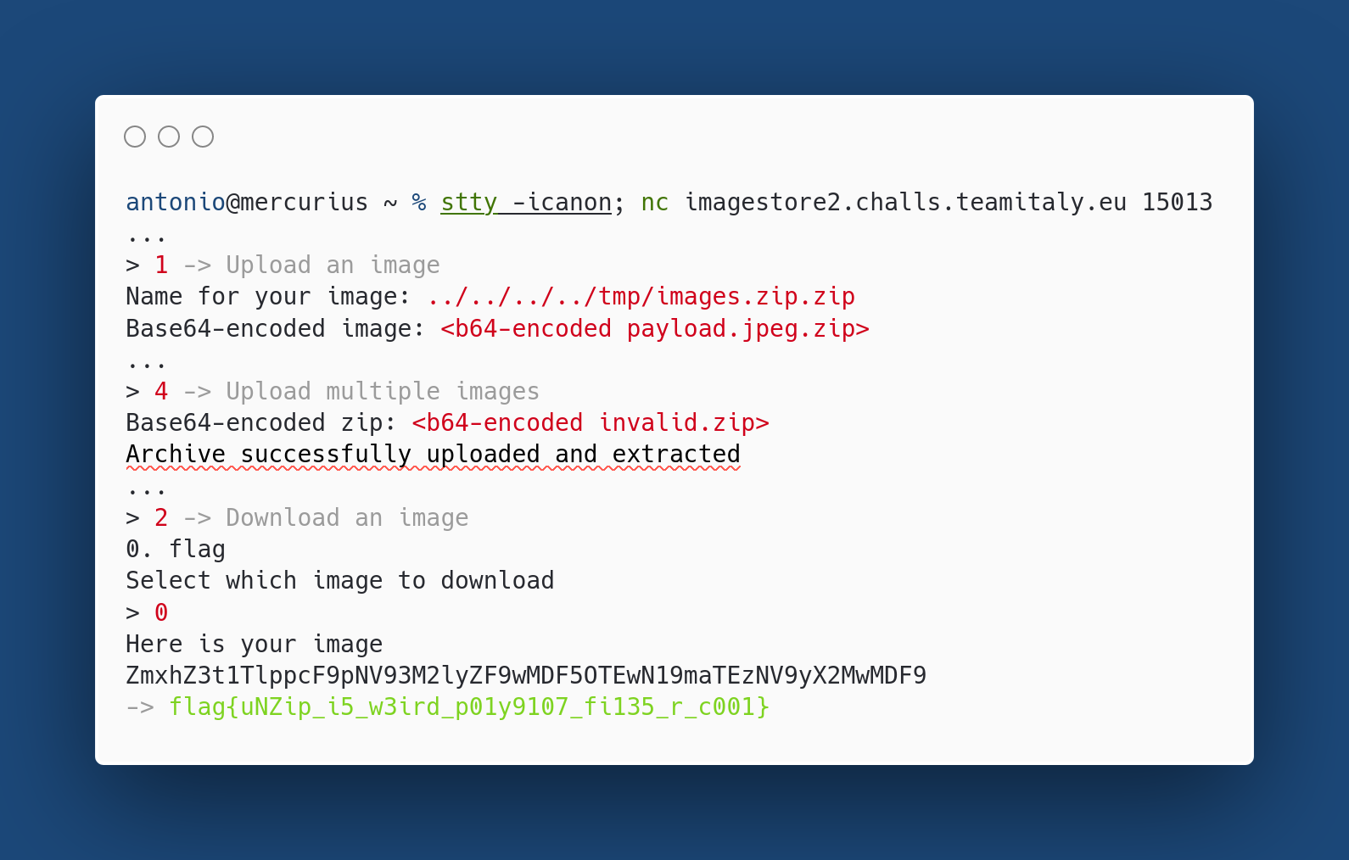
It’s needed to input long lines

Slide 52
Conclusions
Don’t trust Magic Bytes.
Don't assume that different software will interpret the same file the same way.
unzip is weird.

